Slide 1
Comparison of the American and Australian Health Care Systems
By Emma Dougall, Emily Josef, Christie Felber and Hamed Al - Yahmedy

Slide 2
Health Care System in America
Health Care System that is also known as health system is actually an organization of people, institutions and resources that deliver health care services to target audience. Health Care System is necessary for every country. Health care system of America is often described as fragmented because there is no centralized office to manage the distribution, placement and health care resources. The health care system of America is effective due to its characteristics.

Slide 3
Health Indicators
Life expectancy
Mortality rates
Proportional mortality
Top four non communicable diseases
1)Cardiovascular disease
2)Cancers
3)Chronic respiratory disease
4) Diabetes

Slide 4
Health Indicators
Top causes of death
USA
Ischaemic heart disease; Alzheimer’s and other dementias; trachea, bronchus, lung cancers; chronic obstructive pulmonary disease; stroke; diabetes mellitus; hypertensive heart disease; colon and rectum cancers; Kidney diseases; and lower respiratory infections
AUS
Ischemic heart disease; stroke; Alzheimer’s and other dementias; trachea, bronchus, lung cancers; chronic obstructive pulmonary disease, colon and rectum cancers; diabetes mellitus; prostate cancer; breast cancer; kidney disease

Slide 5
Health Indicators
Health systems
Physician density
Nursing and midwifery density

Slide 6
Role of Government
Government does not affect most people using the healthcare system
61% covered by private insurance
Key difference: Universal health care system in AU means less people using private insurance
Medicare- for elderly and disabled
Funded entirely by federal government
Key difference: All Australian citizens eligible for Medicare system
Medicaid- for economically disadvantaged
Federal government gives money to state governments who determine how to allocate
Affordable Care Act (Obamacare)

Slide 7
Affordable Care Act
Major government intervention on healthcare system
2 pieces of legislation
Enacted in 2010
Government now pays for 43% of healthcare costs
Established “Marketplace”
Expanded Medicare
Patient protections
Free preventative health

Slide 8
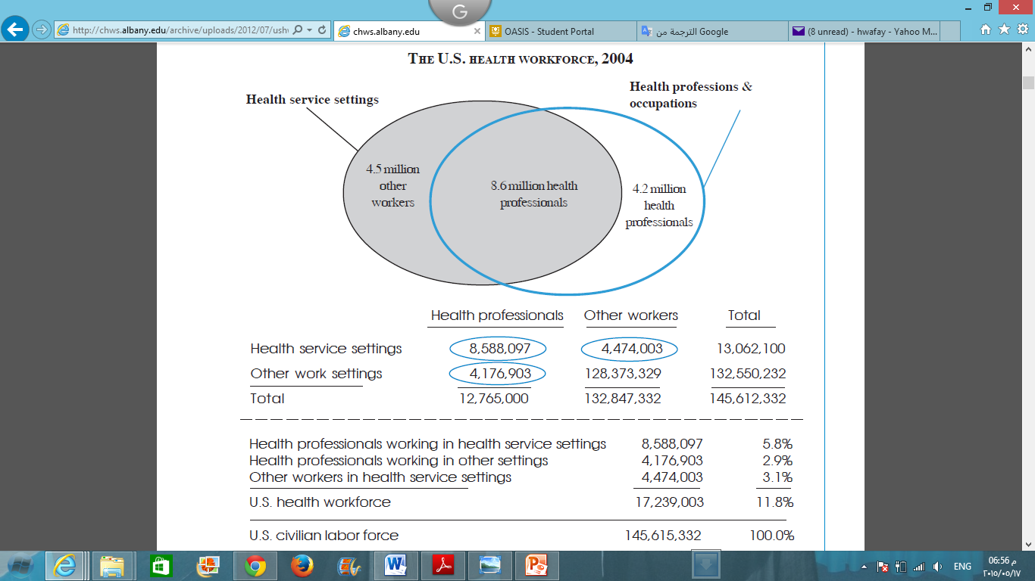
Work Force
This health care system is the largest employer in America. Near about 145.612 million people are employed here. Like physicians , Nurses, paramedics,… etc.

Slide 9
Medicare
Department of Health and Human Services is the federal agency that runs the Medicare Program and monitors Medicaid programs
Medicare is funded entirely by the federal government of America. This money comes from
Taxes
Interest from trust funds
Medicare Australia is funded and administered by the Australian Government

Slide 10
Medicaid
is jointly funded by the federal government and states
pays states a specified percentage of program expenditures, called the Federal Medical Assistance Percentage (FMAP)
children’s health insurance program (CHIP)
funded by the federal government and states
Grants from The Children's Health Insurance Program Reauthorization Act
April 2010, CMS awarded $10 million in federal grants to Indian health providers to enroll and retain eligible American Indian and Alaska Native children in Medicaid and CHIP

Slide 11
Affordable Care Act
Also known as Obama Care
Funded by the federal government
tax payers money
Grants from Health and Human Services

Slide 12
Conclusion
Key differences
Health Indicators
Australia has better health outcomes in almost every category
Role of Government
More people in the U.S. use private health insurance
Government provides most of funding for Australia
Funding
Medicare
Workforce
Nurses and midwives make up majority of workforce in Australia

Slide 13
References
COSTS, T. (2015). THE HEALTH CARE SYSTEMS OF AUSTRALIA AND THE UNITED STATES: A COMPARISON OF GOVERNMENTAL ACTION AND LEGISLATION TO CONTROL COSTS. Academia.edu. Retrieved 24 April 2015, from http://www.academia.edu/1173889/THE_HEALTH_CARE_SYSTEMS_OF_AUSTRALIA_AND_THE_UNITED_STATES_A_COMPARISON_OF_GOVERNMENTAL_ACTION_AND_LEGISLATION_TO_CONTROL_COSTS
David Blumenthal, M. M. (2015, May 6). The Affordable Care Act at 5 Years. New England Journal of Medicine . Boston, MA, USA: Massachusetts Medical Society.
Dethwench.com,. (2014). 10 Main Characteristics of the U.S. Health Care System | DethWench Professional Services. Retrieved 24 April 2015, from http://www.dethwench.com/?p=935
Medicare.gov. (n.d.). How is Medicare Funded? Retrieved from http://www.medicare.gov/about-us/how-medicare-is-funded/medicare-funding.html
Medicaid.gov. (n.d.). Financing. Retrieved from http://medicaid.gov/chip/financing/financing.html (a)

Slide 14
Medicaid.gov. (n.d.). CHIPRA Grants. Retrieved from http://medicaid.gov/chip/chipra-grants/chipra-grants.html
Ridic, G., Gleason, S., & Ridic, O. (2012). Comparisons of Health Care Systems in the United States, Germany and Canada. Materia Socio-Medica,24(2), 112–120. doi:10.5455/msm.2012.24.112-120
The New York Center for Health Workforce Studies, (2006). The United States Health Workforce Profile. Retieved from http://chws.albany.edu/archive/uploads/2012/07/ushwprofile2006.pdf
U.S. Department of Health and Human Services. (2010). Healthcare. Retrieved May 13, 2015, from hhs.gov: http://www.hhs.gov/healthcare/rights/
U.S. Department of Health & Human Services. (2014). HHS awards $36.3 million in Affordable Care Act funding to reward and expand quality improvement in health centers. Retrieved from http://www.hhs.gov/news/press/2014pres/12/20141209b.html
U.S. Department of Health & Human Services. (2014). HHS awards more than $295 million in Affordable Care Act funds to increase access to primary care at health centers. Retrieved from http://www.hhs.gov/news/press/2014pres/09/20140912a.html

Slide 15
World Health Organisation. (2014a). Noncommunicable diseases (NCD) country profiles. Retrieved from: http://www.who.int/nmh/countries/usa_en.pdf?ua=1
World Health Organisation. (2014b). United States of America key indicators. Retrieved from: http://apps.who.int/gho/data/node.cco.ki-USA?lang=en
World Health Organisation. (2015a). Australia: WHO statistical profile. Retrieved from: http://www.who.int/gho/countries/aus.pdf?ua=1
World Health Organisation. (2015b). United States of America: WHO statistical profile. Retrieved from: http://www.who.int/gho/countries/usa.pdf

