Slide 1
Literature Review
Vlad Krotov
Based on Webster & Watson (2002)

Slide 2
Overview
What is literature review?
Why you do literature review
How you do literature review
How to write literature review

Slide 3
What is literature review?
Literature Review: Discussion of published work in a particular subject area
Can be just a simple summary of the sources
Summary: is a recap of the important information of the source
But usually, it’s synthesis
Synthesis: is a consolidation and re-organization of that information.

Slide 4
What is literature review?
Literature Review: Discussion of published work in a particular subject area
Can be just a simple summary of the sources
Summary: is a recap of the important information of the source [LIST]
But usually, it’s synthesis [STORY]
Synthesis: is a consolidation and re-organization of that information
May interpret and/or evaluate publish sources

Slide 5
Why you do literature review
To educate yourself about a particular subject
To show that your research is novel; it makes a contribution to a particular subject
To formulate your research questions
To come up with theory

Slide 6
How you do literature review (1)
Think about keywords related to your problem area
You may start out by reading a book on the subject
Search one of the following databases for your keywords:
EBSCO
PROQUEST
EMERALD
JSTOR

Slide 7
How you do literature review (2)
You may also use Google Scholar to do a search on your subject
You may not find full-text, but Google Scholar may be better in terms of speed, convenience
It’s a good idea to start with a few recent articles in top journals. Once you find an article of this type do
Forward reference analysis (works that cite the article)
Backward reference analysis (works that are cited by the article)
It’s also good idea to find a recent dissertation on your subject; you can use the dissertation’s literature review to educate yourself about the subject and get the references list
Use PROQUEST Dissertations & Theses database

Slide 8
How you do literature review (3)
Once you find a good article, save it to your hard drive using a particular naming convention:
AuthorLastName_ShortTitle_JournalAbbreviation_Year
Example: Krotov_RFID_JTAER_2008.pdf
Once you decide to use a particular article in your writing, create an entry into a references manager
MS Word
EndNote

Slide 9
How to write literature review
Author-centric perspective
Concept-centric perspective

Slide 10
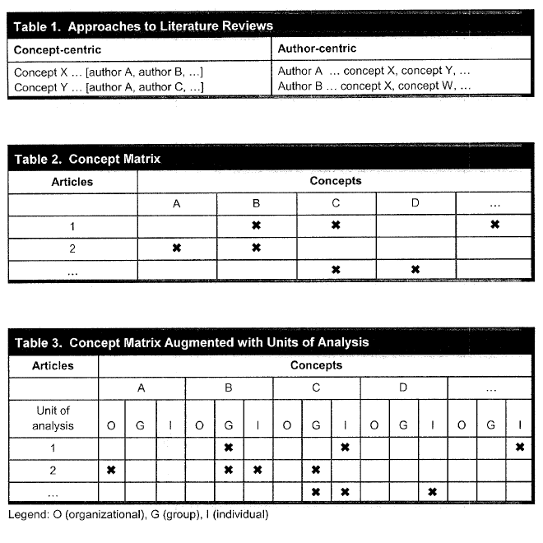
Source: Webster & Watson, 2002

