Slide 1
WHO ARE MY HEROES?
Example provided by: Michael sahota

Slide 2
At first I thought, I don’t have any heroes. But then my mind started wandering. My first hero surprised me. A lot.
But the really interesting part is…
Why They Are Your Hero
I am sharing this exercise because it can help you discover who you really are and what is important for you. For me this short activity was profoundly insightful.
Notes:
By Staying motivated, focused, and determined will assist with my goal

Slide 3
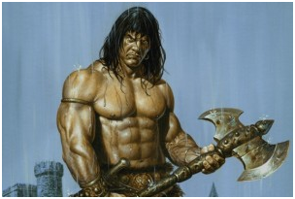
I imagine that at this point many readers are having a hard time relating to my hero or are perhaps even begin to wonder about me as a person. I was mystified myself until I thought about what attributes of Conan make him a hero for me: Strength of mind, courage, and for doing what is right. Conan strictly adhered to the warrior code and would often get into all kinds of difficult situations for doing the right thing no matter what the cost. Conan spent much of his life as a wandering mercenary – I finally seems to have found a path as a consultant in the guise of an Agile Coach. At a young age, Conan was taught what was best in life: “To crush your enemies, see them driven before you and hear the lamentations of the women.” Metaphorically, I see this aligned with the Good To Great management practice of getting the right people on the bus.
#1: Conan the Barbarian

Slide 4
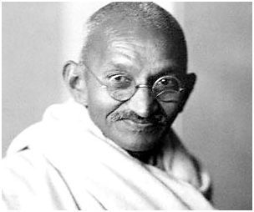
He is my hero for selflessness, courage and wisdom. Gandhi believed in a cause and purpose greater than himself. So do I. My mission is to make a difference in the lives of the people and companies I work with. “Be the change you want to see” is a famous statement from Gandhi and is central to how I think about myself and my work. Whether at home with my kids or working with clients, the better I am at modeling useful behaviours, the more effective I am in helping others. One consequence of this is that I am very dedicated to not only learning useful tools (communication, facilitation, etc.) but more importantly mastering my inner game and developing myself as a human being. Like Stephen Covey says, victory begins at home.
#2: Mahatma Gandhi

Slide 5
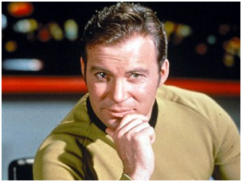
I’m 42 and I watched a lot of Star Trek when I was a kid. The aspects of Captain Kirk that I admire are leadership, ingenuity, boldness and passion. Leadership: Kirk pursued his objectives with a single-minded purpose. He was caring and supportive of his crew and yet could make difficult decisions in times of great need. Ingenuity: Perhaps creativity captures what I mean. With laser-like focus on a goal, there were no holds barred in how it was achieved. I get goose bumps when I think of Kobayashi Maru – a demonstration of changing the rules of the game (literally) in order to win. Passion: Kirk brought energy to any situation he was involved in. He lived life with a vim and vigor, one day at a time.
#3: Captain James T. Kirk

Slide 6
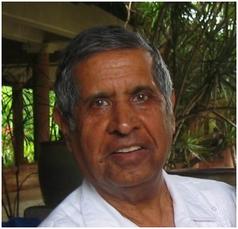
I was startled and perhaps even alarmed to find my dad on my list of heroes since I am still working through the usual stuff that goes on in families. When I started to think about what I admired in him, I realized I admire him for doing the right thing and having a strong code of ethics. My dad has a strong sense of ethics that would often put him controversial situations with those less concerned. One simple example: I remember as a kid when we visited his office and would use the photocopier (when prepping to play one of a myriad of games) he would have us keep track of the number of copies and pay the cost into petty cash. I still think about this today – when I am at a client site and use a printer, I make sure to offset the cost. Sacrifice. When if came to doing the right thing, my dad was prepared to make whatever sacrifices were needed. He put his job and career on the line to fight for what he thought was best for Ryerson University (where he worked) and his coworkers.
#4: Sarwan Sahota

Slide 7
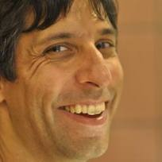
When I look at my heroes, I see they have a lot in common that define how I see myself and what I value. Heroes are what drive our behavior. Do the right thing regardless of personal cost. This is what defines me. It is a chilling and profound insight. The scary part is that it explains why I have cared more than others around me for doing what is best for the people, for the team, for the company. It explains why I have swum so hard against the current to the point of rupturing relations and employment. And my own personal cost has been high. About the Author Michael Sahota is a Consultant, Trainer, and Certified Scrum Coach in Toronto, Michael works with businesses to accelerate delivery of value and help organizations transform to workplaces of joy and meaning. So Who are your Heroes? I encourage you to take some time to courageously delve into some self-discovery and complete this short exercise. Share your insights with the rest of the class here, as I have shared mine with you.
Deep Insights: What Defines Me

