Slide 1
Sustainable passive solar housing in Himalayas
Submitted By: Preethi Uppin
Maninder Singh Hunjan
Nadeem Ahmad

Slide 2
Introduction What is passive solar housing ?
Passive Solar architecture aims at harnessing region’s natural solar energy sources.
It uses the solar radiation in winters to heat up the interiors of the house.
In this approach, the house itself or some element of it takes advantage of natural energy characteristics in materials and air created by exposure to the sun.
The house collect solar radiation during the day, absorb the heat and enables the rooms to remain warm both during day and night.

Slide 3
About the Himalayas
The cold desert of the western Indian Himalayas is located at 3500 meters above sea level in Ladakh, Jammu & Kashmir and Himachal Pradesh states.
These regions experience severe environmental conditions such as the temperature falls below -20 C, scarcity of biomass, low rainfall and roads being closed for six months of the year.
Women and children spend two months in summer collecting biomass to heat the rooms during long winter, but energy vulnerability still leads to sub-zero indoor temperatures coupled with indoor air pollution.
It is necessary to design sustainable, energy efficient and economical warm houses for the better living of these people.

Slide 4
Climatic conditions
Ladakh lies on the rain shadow side of the Himalayan. Where dry monsoon winds reach and left after being robbed of it moisture.
The district combines the condition of both arctic and desert climate. Therefore Ladakh is often called “cold desert”.
Exceptionally harsh cold desert climate conditions.
Mean temperature
Summer midday: 12 to 20 c
Summer night: 2 to 7 c
Winter midday: -7 to -8 c
Winter night: -14 to 0 c

Slide 5
Objectives of passive solar housing
People have the benefit of a warmer and healthier indoor environment
Costs for room heating will be significantly reduced thereby making the people financially healthy
Electrical and fossil fuel energy consumption for room/space heating will be reduced
Environmental sustainability
Improve the living conditions of thousands of families and facilitate their economic, human and social development while reducing pressure on the local and global environment.
Promote energy efficient systems

Slide 6
Challenges to project
Local government policies can be a hurdle in the way
Raising funds for the project is difficult
Dynamics of the village structures have to be carefully taken into account while approaching individual households and groups
PSH is termed as poor man's alternative therefore, the richer are hesitant to implement it.

Slide 7
Pragmatic Approach
This project will have both qualitative and quantitative approach.
It is important to collect and convert data into numerical form so that statistical conclusions can be drawn.
At the same time, it is necessary to have record and analyze the human behavior and experience.

Slide 8
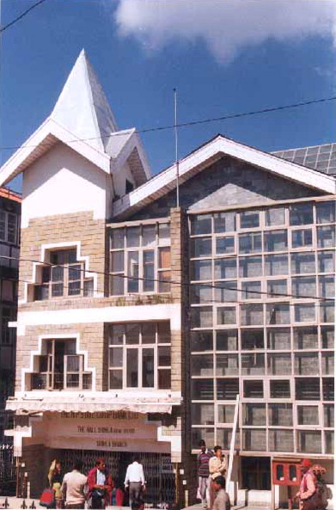
Case Study
Under the Passive Solar Building Programme, more than 100 buildings have been constructed in the high altitude region of the Indian State of Himachal Pradesh.
In this case study, we will discuss about the thermal performance of a passive solar bank building at Shimla.
Solar housing was implemented on the State Bank of Patiala. This project is located on the Mall road in Shimla.

Slide 9
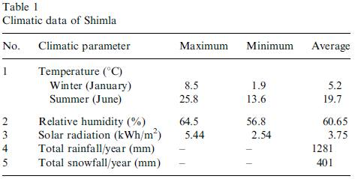
Climate of Shimla

Slide 10
Features
air-lock lobby at the main entrance to reduce heat losses
external walls (north, south, west) are 9-in.thick brick walls
eastern wall is 18-in.-thick brick wall as it adjoins
another solar passive State Bank of Patiala building
two sunspaces, each of size 1.8 m2, are provided on the south face on the first and second floors
a 36-m2 heat collecting solar wall on southern face;

Slide 11
Features
roof-top solar air heating system with a 45-kW electric backup heating system
double-glazed sealed windows with wooden frame shutters on west and north sides
buffer zone has been created on the north face of building to reduce heat losses
west wall of the officer rooms are insulated with wooden panels
The exposed roof is thermally insulated by 50-mm-thick resin-bonded mineral wool

Slide 12
Monitoring
In order to see the efficiency of the solar passive features the monitoring of the H.P. Co-operative Bank solar building at Shimla was done during the period 1998–2001.
The temperature variation in all the rooms and ambient temperature were recorded using digital temperature sensors.
The average outside temperature recorded was 5.5 °C and the average inside temperature was recorded as 18.8 °C

Slide 13
Monitoring
The monitoring shows that the infiltration losses from buffer zone can be reduced further by insulating it properly.
The air-lock lobby at the main entrance is kept open by the bank authorities for the convenience of customers resulting in heat losses.
The air leakage from solar heat collecting wall was also noticed during the monitoring of the building which can be reduced.

Slide 14
Conclusion
Based on the success of introducing passive solar technology in the State of Himachal Pradesh, a similar strategy can be adopted for propagation of solar buildings in high altitude regions of India and other countries with cold climatic conditions.
As a result of the project, people have the benefit of a warmer and healthier indoor environment and they are able to earn more money in the winter months.
Costs of heating the rooms are significantly reduced and people are better off financially with their improved incomes.
There is a broader awareness of environmental issues due to the large media campaigns on both energy efficiency and climate change

