Slide 1
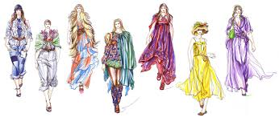
E-Fashion Week

Slide 2
A fashion week is a fashion industry event, lasting approximately one week , which allows fashion designers, brands or "houses" to display their latest collections in runway shows and buyers and the media to take a look at the latest trends. Most importantly, these events let the industry know what's "in" and what's "out" for the season.

Slide 3
Mission Statement
Showing fashion week events and its products directly live.
Summarize and display scheduling the events, with explanations of what will be displayed in each event.
Mention the names of the designers with a brief explanation of the most important achievements for each person

Slide 4
Mission Statement
Uniqueness:
Unique presentation through the Internet.
Building a bridge between those interested in fashion and fashion designers.
Facilitate the buying and selling process through our website.

Slide 5
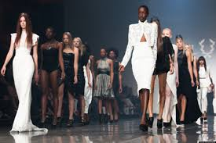
Features
search fashion based on different criteria, by, designer, brand, model,..etc
we have a special feature called" fashion alarm" keeps the member updating and aware of upcoming events.
we have also designers page which allows the viewers to comment on the designs.
Have online Auctions
We will dictate the last
Day of the show for new designer

Slide 6
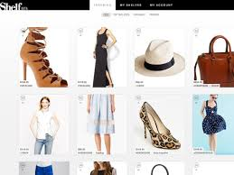
Features
Tow types of memberships:
-free membership
Have a limited access
Ability to buy offer products.
-Primary membership:
Have a full access
Ability to buy and return products
Can bet on the online exclusive auction

Slide 7
Market Analysis
Strengths
The lack of competition now.
Weakness
small capital
Threats
A new idea.
Opportunities
Global proliferation.
The idea is unique.
Market needs
Put a new mark on the fashion world.
Acquisitions on the market.
The magnitude of data
Build customer confidence.
Foreign competition

Slide 8
Financial Requirements
Financial Requirements
Funding |  | $ 27,000
Website Developing Costs- 1st Year ( Web Designer, web programmer, And developer) |  | 5,000
Hosting for next 5 years with Maintenance( Yahoo small business website) |  | 4,000
Imaging Machinery and Equipment and advertising |  | 19.0000

Slide 9
Competitive Advantage
Competitive Edge:
Our customers are from all around the world
Free membership to use the site
Customers can track and buy products
Trustworthy
Customers can provide feedback
Exclusive shows and easy access from all around the world
Save money and time

Slide 10
Advertisements
Advertisements : We well advertise everywhere, via social media( Facebook, twitter, Instagram) , news papers, and magazines.
We will advertise though stores like Macy's and Nordstrom

Slide 11
Thank you for listening

