Slide 1
Context of Health Care Financial Management
Chapter 1

Slide 2
Learning Objectives
Identify key elements that are driving changes in health care delivery
Identify key approaches to controlling health care costs and resulting ethical issues
Identify key changes in reimbursement mechanisms to providers

Slide 3
Lowering Costs
Patient Protection and Affordable Care Act (ACA)
CMS trying to control rising costs
Value Based Purchasing (VBP)

Slide 4
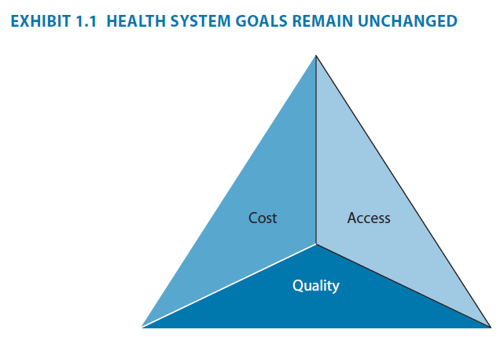
Goals of the Health Care System
Access
Cost
Quality

Slide 5
Changing Methods Of Health Care Financing and Delivery
Requirement that almost all individuals have insurance coverage
Requirement that states create insurance exchanges
Provisions for expansion of Medicaid
Provisions for medical loss ratio and premium rate reviews
Bundled payments and VBP
Accountable Care Organizations

Slide 6
Trends
Rise of uninsured from 36 million to 50 million 2001-2010
ACA authorizes competitive insurance marketplace
Rise of uncompensated care for the uninsured 2001-2011
Accountable Care Organizations
Patient Centered Medical Home
New technology
VBP

Slide 7
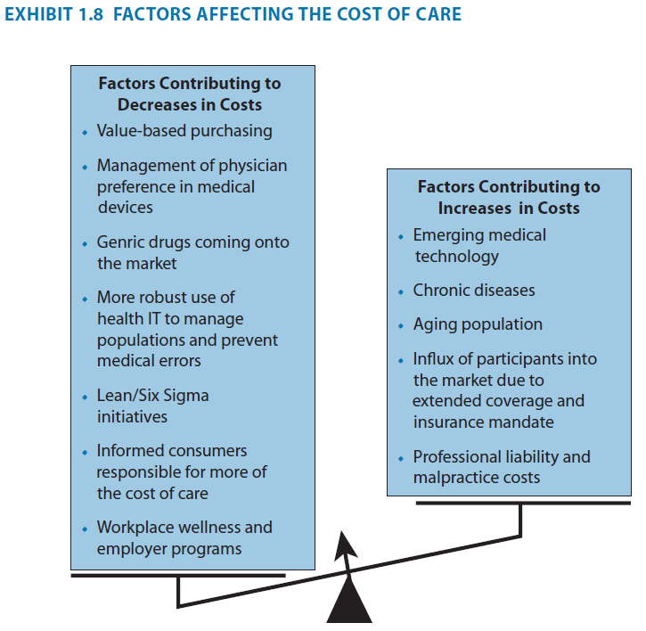
Factors Affecting the Cost of Care

Slide 8
Impacts to Reimbursement
Cost Accounting Systems
Group Purchasing Organizations
Reengineering/Redesigning
Mergers and Acquisitions
Retail Health Care
Medical Tourism
Compliance
Recovery Audit Contractors (RACs)
VBP
New DRG System
ICD 10

Slide 9
Summary
Health care administrator faces numerous complex issues when making strategic and financial decisions.
High ethical standards must be demonstrated

