Slide 1
MGT 214 OPERATIONS MANAGEMENT
CHAPTER 06
Layout Decisions
Prepared by: Ms. Dalal Bamufleh

Slide 2
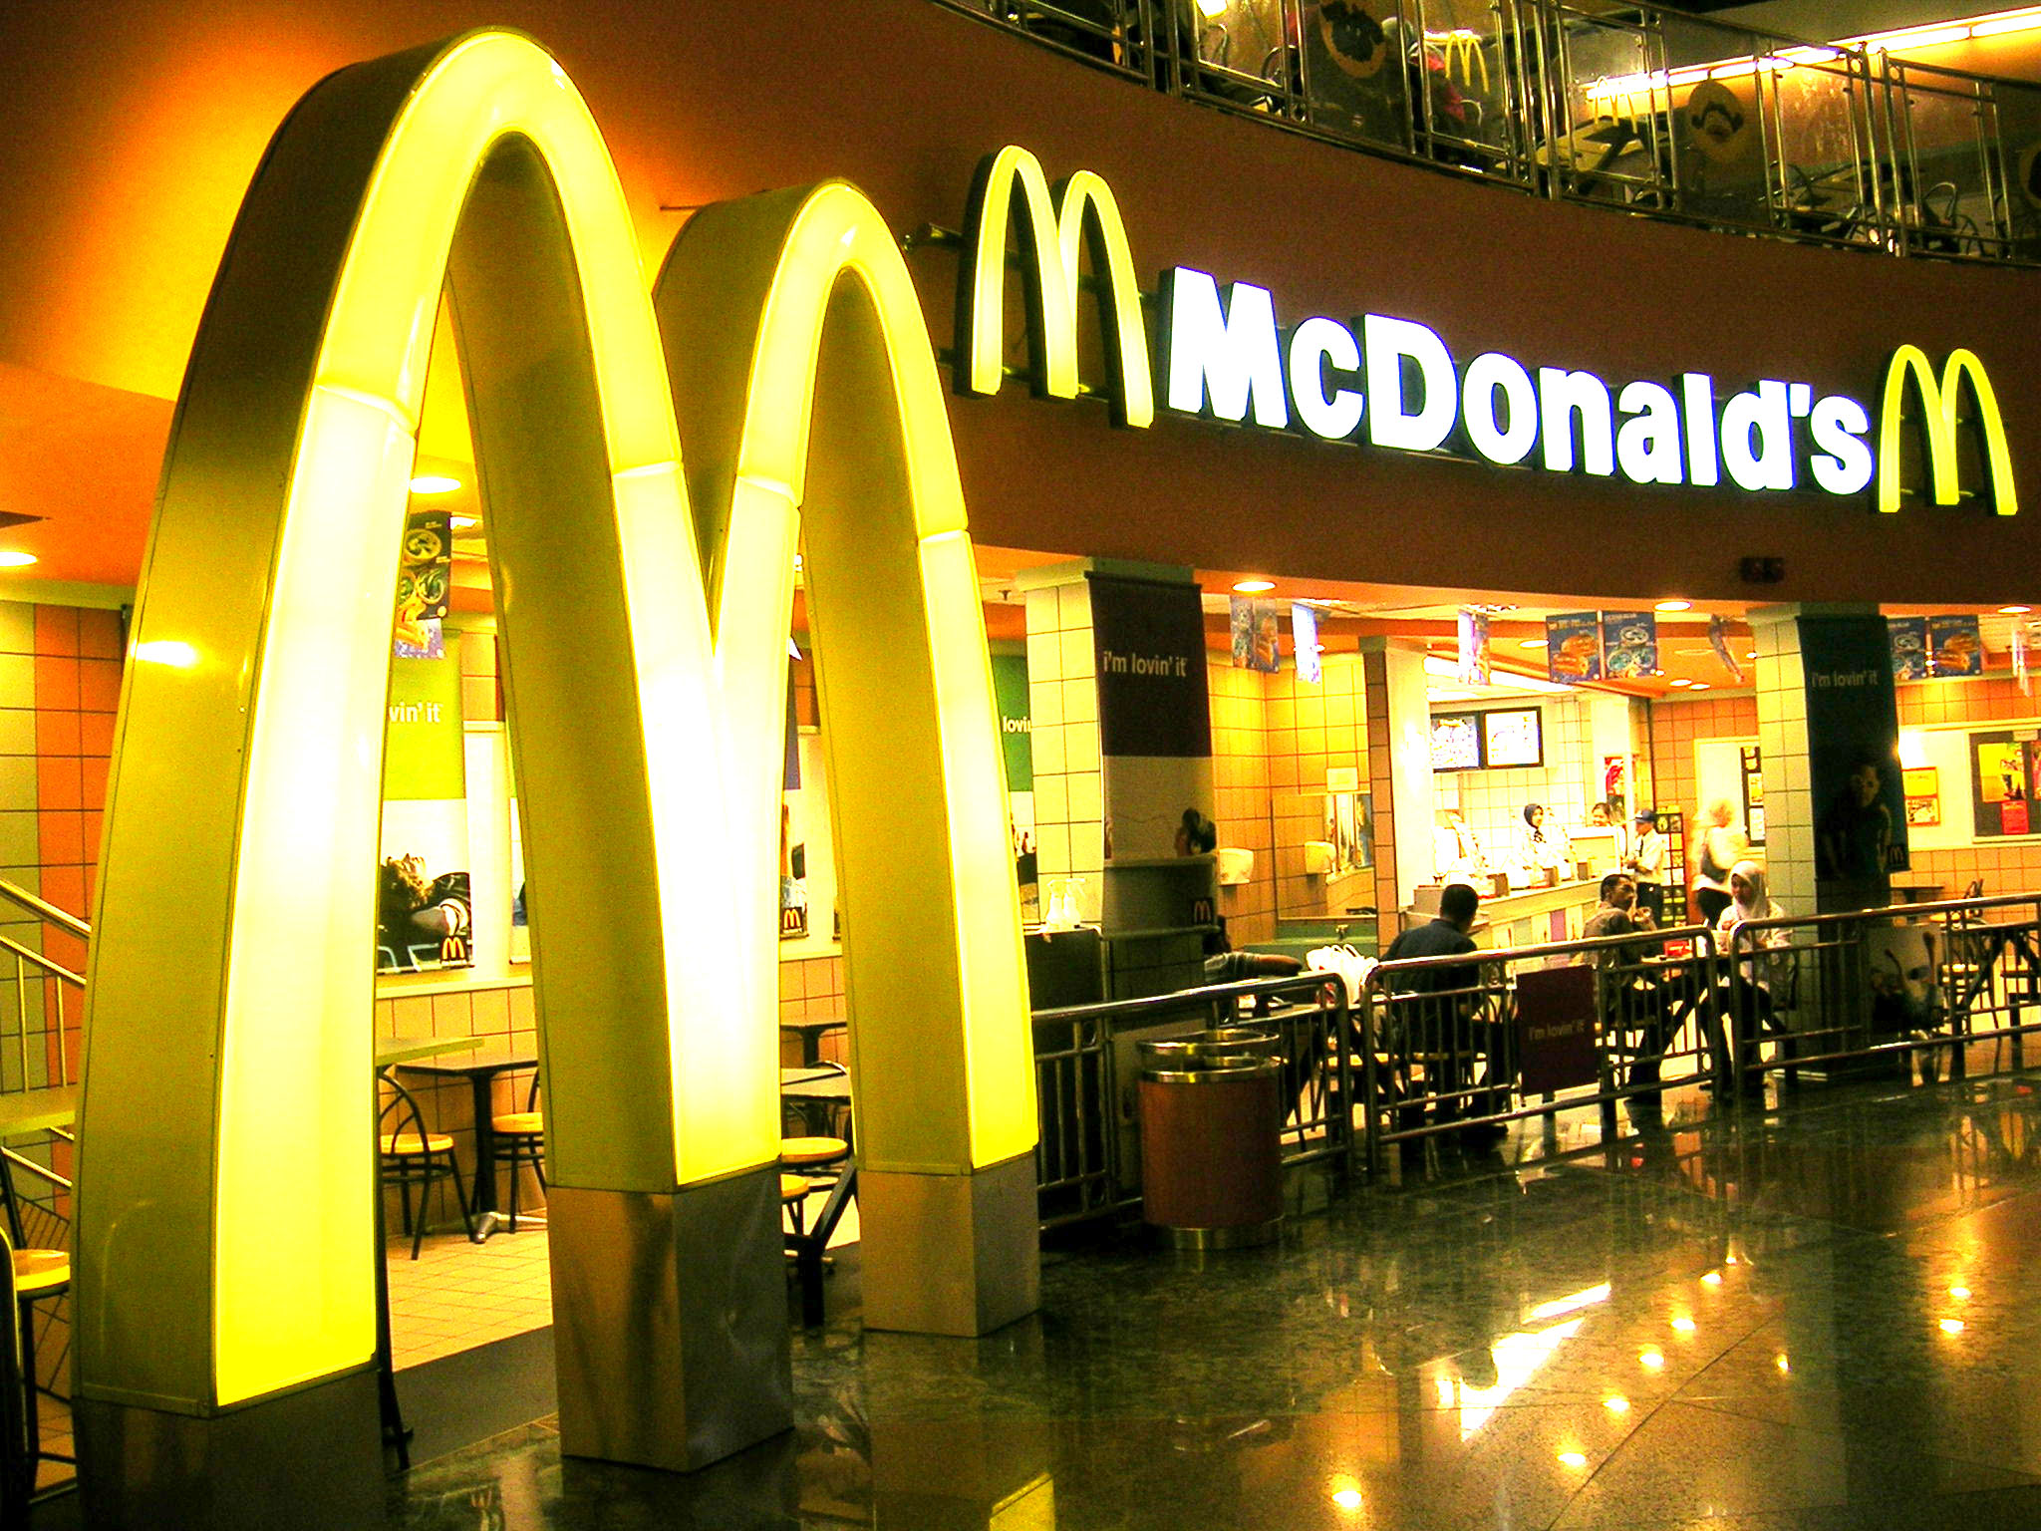
MCDONALD’S LOOK FOR COMPETITIVE ADVANTAGE THROUGH LAYOUT

Slide 3
MCDONALD’S LOOK FOR COMPETITIVE ADVANTAGE THROUGH LAYOUT
Indoor seating (1950s)
Drive-through window (1970s)
Adding breakfast to the menu (1980s)
Adding play areas (late 1980s)
Redesign of the kitchens (1990s)
Self-service kiosk (2004)
21st Century look: 3 dining sections

Slide 4
MCDONALD’S LOOK FOR COMPETITIVE ADVANTAGE THROUGH LAYOUT
Three separate dining areas
Linger zone with comfortable chairs and Wi-Fi connections
Grab and go zone with tall counters and with bar stools.
Flexible zone for kids and families with colorful and movable furniture
Facility layout is a source of competitive advantage (CSF)

Slide 5
Strategic Importance of Layout Decisions
The objective of layout strategy is to develop an effective and efficient layout that will meet the firm’s competitive needs and requirements.
An effective layout can help an organization achieve a strategy that support differentiation, low cost or response.

Slide 6
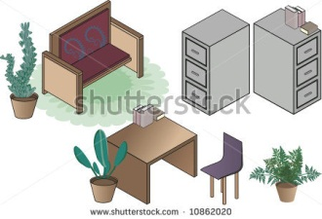
Strategic Importance of Layout Decisions
Layout Design Considerations:
Higher utilization of space, equipment, and people
Improved flow of information, materials, or people
Improved employee morale and safer working conditions
Improved customer/client interaction
Flexibility
Layout designs needs to be viewed as dynamic

Slide 7
Types of Layout
Office layout
Retail layout
Warehouse layout
Fixed-position layout
Process-oriented layout
Work-cell layout
Product-oriented layout

Slide 8
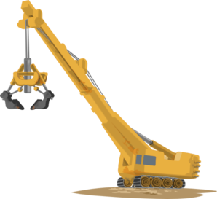
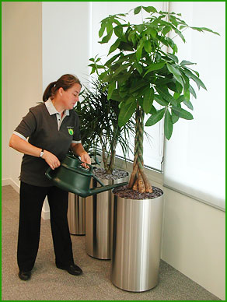
Types of Layout
Good layouts requires determining the following:
Material handling equipment
Capacity and space requirements
Environment and aesthetics
Flows of information
Cost of moving between various work areas

Slide 9
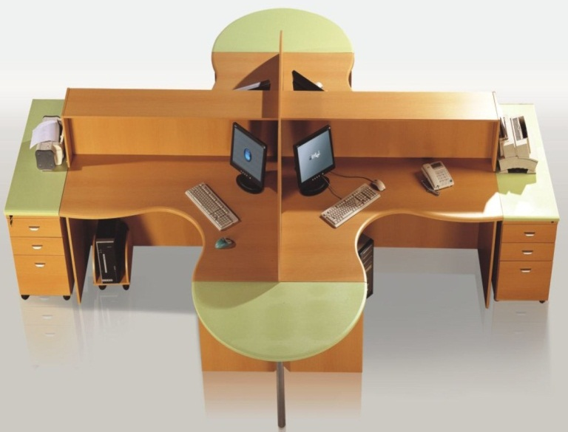
Office Layout
Requires the grouping of workers, their equipment, and spaces to provide comfort, safety, and movement of information
Movement of information is main distinction
Typically in state of flux due to frequent technological changes
Electronic data and paper work
Relationship chart

Slide 10
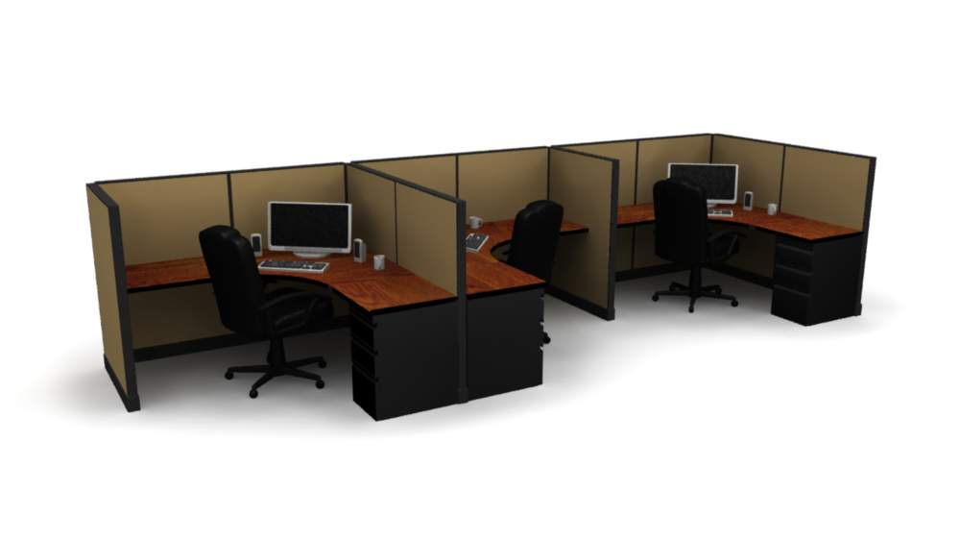
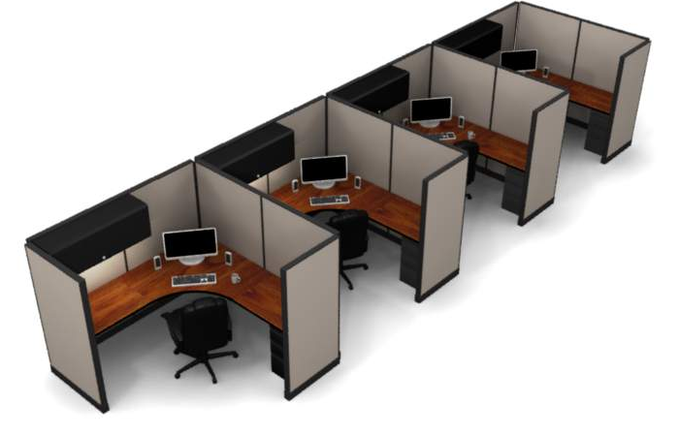
Office Layout
Some of the universal layout considerations: working conditions, teamwork, authority …etc
Private or open cubicles?
Open Cubicles
Private Cubicles

Slide 11
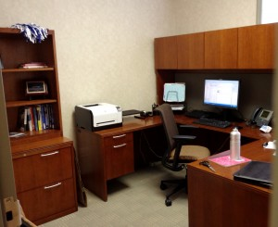
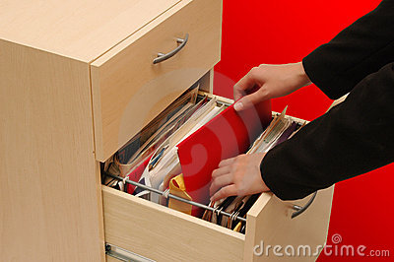
Office Layout
Private office
Low or high file cabinets

Slide 12
Office Layout
Same entrance, rest room, lockers and cafeteria for all employees?
Two major trends:
Technology such as cell phone, iPods, faxes, Internet, and laptop computers increase layout flexibility.
Modern firms create dynamic needs for space and services.

Slide 13
Retail Layout
Objective is to maximize profitability per square foot of floor space
Sales and profitability vary directly with customer exposure
OM try to expose customers to as many products as possible
 rate of exposure,  sales and  return on investment
How to change exposure?

Slide 14
Retail Layout
Five Helpful Ideas for Supermarket Layout:
Locate high-draw items around the periphery of the store
Use prominent locations for high-impulse and high-margin items
Distribute power items to both sides of an aisle and disperse them to increase viewing of other items
Use end-aisle locations
Convey mission of store through careful positioning of lead-off department

Slide 15
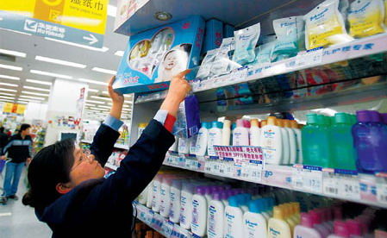
Retail Layout
Category Management
Slotting fees: Manufacturers pay fees to retailers to get the retailers to display (slot) their product
Contributing factors:
Limited shelf space
Massive new products
Limit small firms ability to expand

Slide 16
Retail Layout
Servicescapes:
Ambient conditions - background characteristics such as lighting, sound, smell, and temperature
Spatial layout and functionality - which involve, aisle characteristics (width, direction, shelf spacing...etc.) , and product grouping
Signs, symbols, and artifacts - characteristics of building design that carry social significance e.g.: Wal-Mart greeter at the door, Disneyland's entrance

Slide 17
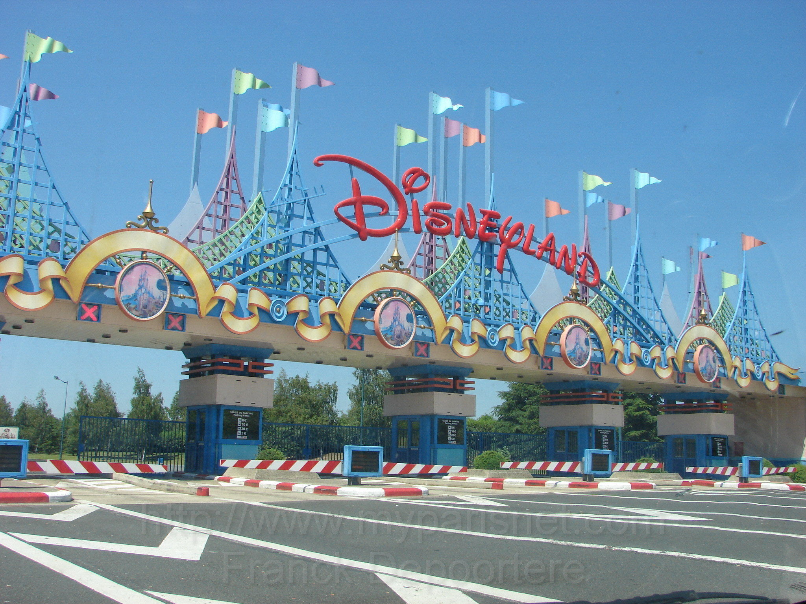

Slide 18
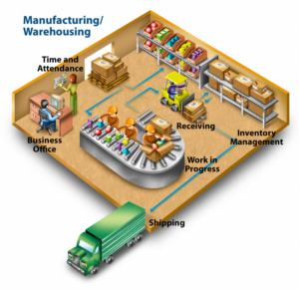
Warehousing and Storage Layouts
Objective is to optimize trade-offs between handling costs and costs associated with warehouse space
Maximize the utilization of the total “cube” of the warehouse – utilize its full volume while maintaining low material handling costs

Slide 19
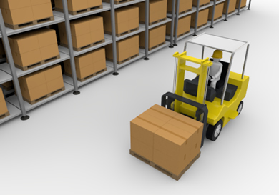
Warehousing and Storage Layouts
Material Handling Costs:
All costs associated with the transaction
Incoming transport
Storage
Finding and moving material
Outgoing transport of the materials to be warehoused
Equipment, people, material, supervision, insurance, and depreciation
Minimize damage and spoilage

Slide 20
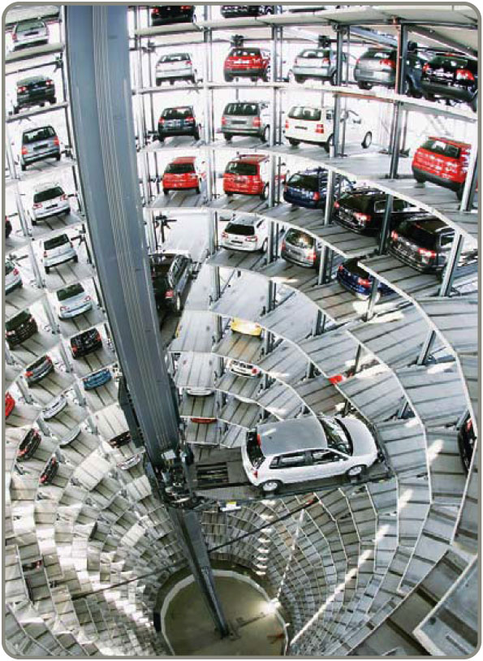
Warehousing and Storage Layouts
Automated Storage and Retrieval Systems (ASRSs) can significantly improve warehouse productivity

Slide 21
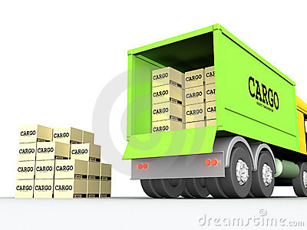
Warehousing and Storage Layouts
An important component of warehouse layout is the relationship between the receiving/ unloading area and the shipping/ loading area.

Slide 22
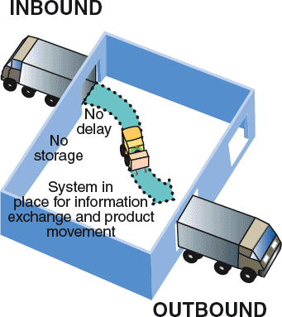
Warehousing and Storage Layouts
1. Cross-Docking
Materials are moved directly from receiving to shipping and are not placed in storage in the warehouse
Reduces distribution, inventory and facility costs
Requires tight scheduling and accurate product identification e.g. bar code

Slide 23
Warehousing and Storage Layouts
2. Random Stocking
Typically requires automatic identification systems (AISs) and effective information systems
Random assignment of stocking locations allows more efficient use of space
Key tasks:
Maintain list of open locations
Maintain accurate records of existing inventory and its locations
Sequence items to minimize travel, and pick time
Combine picking orders to reduce picking time
Assign classes of items to particular areas
 facility utilization,  labor cost, but requires very accurate records

Slide 24
Warehousing and Storage Layouts
3. Customizing
Value-added activities performed at the warehouse
Assembly of components
Loading software
Repairs
Customized labeling and packaging

Slide 25
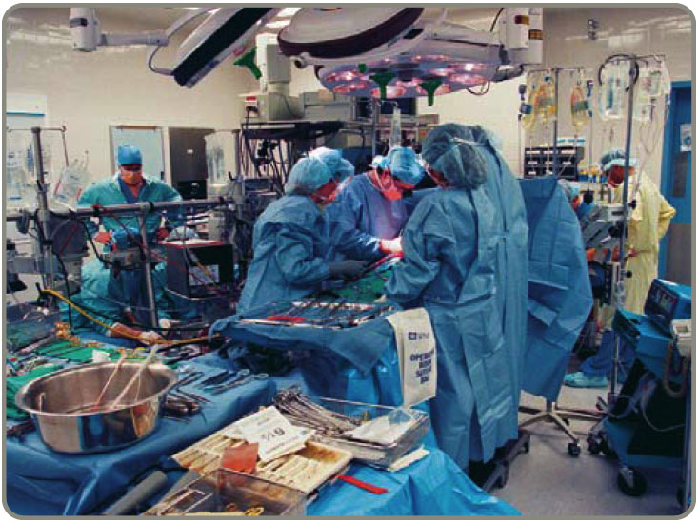
Fixed-Position Layout
Project remains in one place and workers and equipment come to site
E.g.: ship, highway, bridge, house, operation room
Complicating factors
Limited space at site
Different materials required at different stages of the project
Volume of materials needed is dynamic

Slide 26
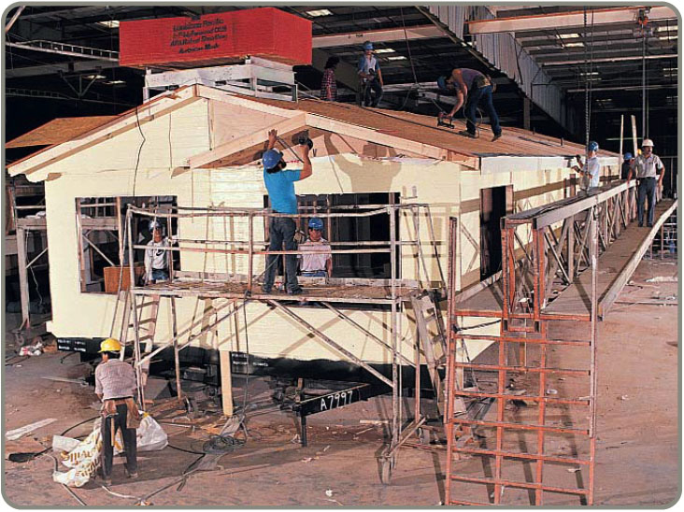
Fixed-Position Layout
Alternative Strategy
As much of the project as possible is completed off-site in a product-oriented facility
This can significantly improve efficiency but is only possible when multiple similar units need to be created

Slide 27
Work Cells
Reorganizes people and machines into groups to focus on single products or product groups
Volume must justify cells
Group technology identifies products that have similar characteristics for particular cells
Cells can be reconfigured as designs or volume changes

Slide 28
Work Cells
Improving Layouts Using Work Cells
+
Current layout - workers in small closed areas. Cannot increase output without a third worker and third set of equipment.
Improved layout - cross-trained workers can assist each other. May be able to add a third worker as additional output is needed.
U-shaped line may reduce employee movement and space requirements while enhancing communication, reducing the number of workers, and facilitating inspection

Slide 29
Work Cells
Improving Layouts Using Work Cells
Current layout - straight lines make it hard to balance tasks because work may not be divided evenly
Improved layout - in U shape, workers have better access. Four cross-trained workers were reduced.
U-shaped line may reduce employee movement and space requirements while enhancing communication, reducing the number of workers, and facilitating inspection

Slide 30
Process-Oriented Layout
Low volume,  high variety
Like machines and equipment are grouped together
Efficient when making products with different requirements, or when handling different needs of customers
Each product requires different sequence of operations
E.g.: ER Process

Slide 31
Process-Oriented Layout
Surgery
ER triage room
Patient A - broken leg
Emergency room admissions
Patient B - erratic heart pacemaker
Laboratories
Radiology
ER Beds
Pharmacy
Billing/exit

Slide 32
Process-Oriented Layout
Advantages:
Flexibility
Capability of handling a wide variety of products or services
Disadvantages:
General-purpose use of equipment  labor skills and cost,  required level of training and experience
Orders take more time to move through the system because of difficult scheduling, changing setup, and unique material handling

Slide 33
Process-Oriented Layout
Arrange departments/ work centers so as to minimize the costs of material handling
Material handling cost in this approach depend on:
Number of loads (or people) moving between centers
Distance-related cost of moving loads (or people) between centers

Slide 34
Process-Oriented Layout
Designing process- oriented layout steps:
Construct a “from-to matrix”
Determine the space requirements
Develop an initial schematic diagram
Determine the cost of this layout
Try to improve the layout
Prepare a detailed plan

Slide 35
Process-Oriented Layout
Example 1:
Page: 385
1. Construct a “from-to matrix”
Number of loads per week
Department Assembly Painting Machine Receiving Shipping Testing
(1) (2) Shop (3) (4) (5) (6)
Assembly (1) 50 100 0 0 20
Painting (2) 30 50 10 0
Machine Shop (3) 20 0 100
Receiving (4) 50 0
Shipping (5) 0
Testing (6)
Department Assembly Painting Machine Receiving Shipping Testing
(1) (2) Shop (3) (4) (5) (6)
Assembly (1)
Painting (2)
Machine Shop (3)
Receiving (4)
Shipping (5)
Testing (6)

Slide 36
Process-Oriented Layout
2. Determine the space requirements
Area 1 Area 2 Area 3
Area 4 Area 5 Area 6
Assembly Painting Machine Shop
Department Department Department
(1) (2) (3)
40’
Receiving Shipping Testing
Department Department Department
(4) (5) (6)
60’

Slide 37
Process-Oriented Layout
3. Develop an initial schematic diagram
100
Assembly
(1)
50
Painting
(2)
30
Machine Shop (3)
20
20
10
50
100
Receiving
(4)
Shipping
(5)
Testing
(6)
50

Slide 38
Process-Oriented Layout
4. Determine the cost of this layout
n
i = 1
n
j = 1
Cost = ∑ ∑ X_{ij} C_{ij}
X= Number of loads
C= Cost for moving load
The cost of moving adjacent department is estimated to be $1, and 2$ for nonadjacent departments.
Cost = $50 + $200 + $40
(1 and 2) (1 and 3) (1 and 6)
+ $30 + $50 + $10
(2 and 3) (2 and 4) (2 and 5)
+ $40 + $100 + $50
(3 and 4) (3 and 6) (4 and 5)
= $570

Slide 39
Process-Oriented Layout
5. Try to improve the layout
30
Painting
(2)
50
Assembly
(1)
100
Machine Shop (3)
10
20
50
20
100
Receiving
(4)
Shipping
(5)
Testing
(6)
50
Cost = 50 + (30X2) + 10 + 50 + 100 + 20 + 100 + (20X2) +50
= $ 480

Slide 40
Process-Oriented Layout
6. Prepare a detailed plan
Area 1 Area 2 Area 3
Area 4 Area 5 Area 6
Painting Assembly Machine Shop
Department Department Department
(1) (2) (3)
40’
Receiving Shipping Testing
Department Department Department
(4) (5) (6)
60’

Slide 41
Repetitive and Product-Oriented Layout
 High volume,  low variety products
Repetitive production and continuous production use product layout.
Two types of layout: Fabrication line and Assembly line.
Fabrication line
Builds components on a series of machines
Machine-paced
Require mechanical or engineering changes to balance

Slide 42
Repetitive and Product-Oriented Layout
Assembly line
Puts fabricated parts together at a series of workstations
Paced by work tasks
Balanced by moving tasks
Both types of lines must be balanced so that the time to perform the work at each station is the same

Slide 43
END OF LECTURE

