Slide 1
ESTABLISHING A EUROPEAN CITY AS A PERMANENT TRAINING CAMP FOR THE PHILADELPHIA 76ERS
Presented by Spiro Doukas
Final Project Submitted for
SPHE 450
Sports Governance
Professor: Spiro G. Doukas

Slide 2
Introduction
Have all 76ers preseason games in a European city.
Will generate more revenues through an expanded fan base.
Young Europeans have embraced the NBA.
The European Union (E.U.) is the 2nd strongest economic entity in the world.

Slide 3
The goals of having a training camp in an E.U. city will be:
Generating excitement around the target country for the NBA.
Persuading local fans / local politicians of benefits of having an NBA team.
Creating team chemistry for 76ers by having training camp with less distraction.

Slide 4
Proposal
Create a permanent training camp for 76ers in Athens, Greece.
Play against the top 8 Greek teams as a preseason.
Athens has several brand new venues / infrastructure from 2004 Olympics.
Greek government looking to lease arenas

Slide 5
Staffing
The total staff would be 40 members.
The basketball team consists of 15 players and 6 coaches.
Additionally, 19 staff members will join the 76ers for preseason trip.
Of these 19 members, 5 will be security, 9 will be employees, and 5 will be temporary employees.
Mr. Doukas will be project manager & Mr. Dave Mackey the assistant project manager.

Slide 6
Budget
Mr. Doukas seeks $955,000 from the NBA:
Leasing a training facility for one month ($65,000)
Chartering a plane from Philadelphia to Athens for 76ers ($205,000)
Hotels, transportation, and restaurants ($405,000)
Security package (5 security experts) ($60,000)
Five temporary employees ($20,000)
Miscellaneous and emergency funds ($200,000)

Slide 7
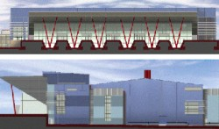
Budget
Hellinikon Basketball Arena
Average price of tickets is 40 Euro ($53.34 U.S.)
Hellinikon basketball arena has 14,000 seat capacity.
Sell outs would generate revenues of $746,760.
Halving these revenues with the opposing team would generate $373,380.
$373,380 x 8 games = $2,987,040.

Slide 8
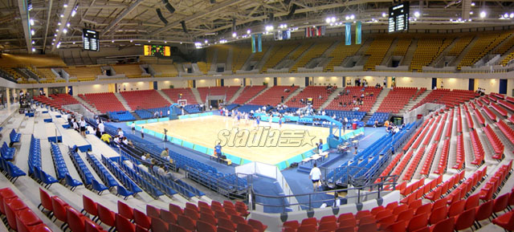
Budget
Hellinikon Basketball Arena
The profit would be $2,032,040 U.S. dollars ($2,987,040 - $955,000= $2,032,040 )

Slide 9
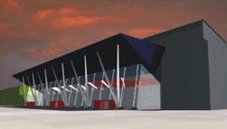
Authorization
Hellinikon Basketball Arena
Facility locations and contracts with Greek basketball teams can be quickly finalized.
Expansion into Europe is a necessity, not a luxury.
Basketball is the world sport after soccer.
The NBA must take advantage of its image internationally.

Slide 10
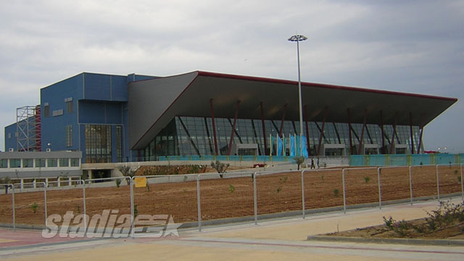
Questions & Comments
76ers and Athens have many opportunities together.
Thank you
Photographs by Stadia.gr
Hellinikon Basketball Arena

